Slide 1
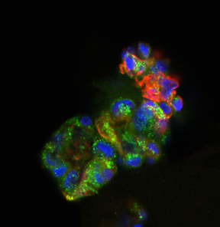
利用肺泡类器官筛选可促进AEC1成熟的信号因子
何远隆
指导教师：林鑫华

Slide 2
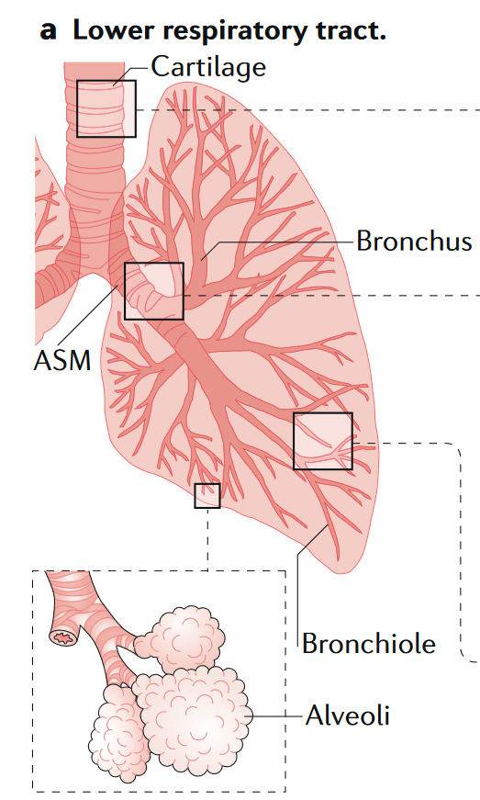
肺泡是肺脏的气体交换最小单元
Zepp et al. Nat Rev Mol Cell Biol. 2019

Slide 3
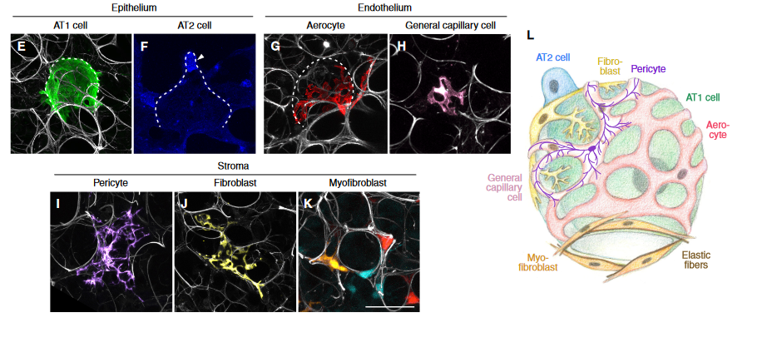
肺泡上皮主要是由AEC1和AEC2组成
气体交换
成体干细胞&
分泌表面活性蛋白
AEC: Alveolar Epithelial Cell
Gillich et al. bioRixiv. 2021
Notes:
肺泡是一种单层鳞状上皮，由肺泡I型细胞（alveolar type I cell, AT1）与肺泡II型细胞（alveolar type II cell, AT2）组成。前者为大而薄的上皮细胞，被认为是气体交换进行的场所；后者为小而圆的柱状上皮细胞，能够大量分泌以磷脂与蛋白质为主的表面活性物质，通过降低表面张力避免肺泡在呼气时塌陷。目前学界主流观点认为，损伤修复中以AT2为执行增殖和分化的干细胞介导发生。
由于太薄了 所以很多时候切片都会看上去是complex 肺泡
#AT2自己还有个Wnt-secreting niche

Slide 4
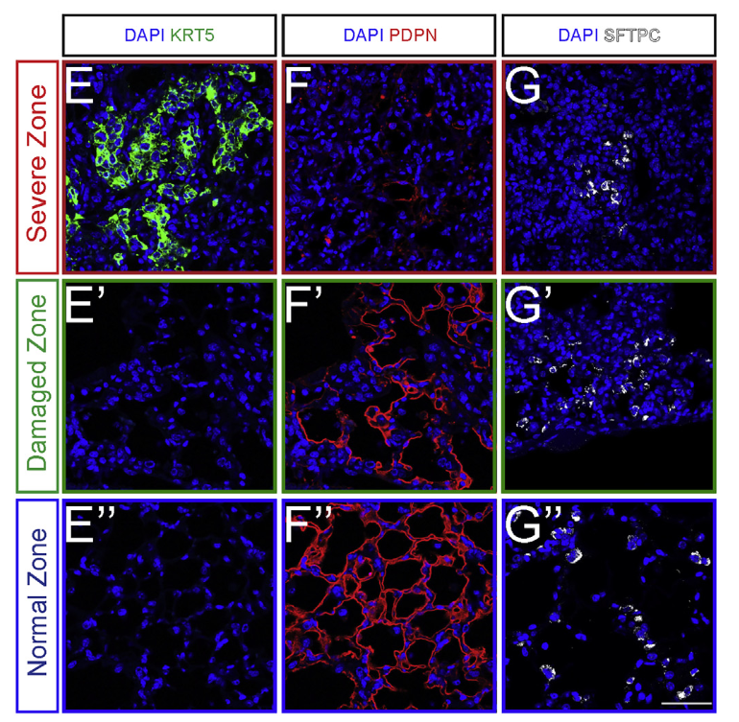
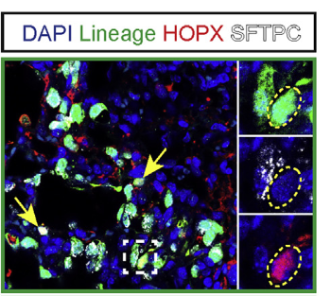
多种成体肺泡再生过程中，AEC2可以转分化成AEC1
流感病毒的损伤修复模型
损伤会造成AT1的丢失
修复过程中依赖AT2转分化
因此研究转分化很重要
Sftpc^{CreERT2};R26^{EYFP}
Damaged Zone
Liberti. Cell Reports. 2021
Notes:
ATII cells proliferate to replace lost cells, and once sufficient cell numbers have been restored, some differentiate into ATI cells to restore normal alveolar structure. Since ATI cells are largely responsible for barrier function and gas exchange, the regeneration of ATI cells is absolutely critical to restore normal lung function.
The lung epithelium serves as a barrier that protects the body from airborne pathogens and prevents leakage of bodily fluids into the airspaces. In the event of epithelial cell death, such as during infection or after exposure to cigarette smoke, the barrier is compromised.
→类器官可以做的一些信号通路实验很多。比如一些敲除/生化/细胞→但是做这些之前，要先搞出来
做这个模型的目的，是要解决科学问题。不是利用这个模型
AT1很重要了
转分化在体内的研究有很多了
体内研究做机制问题：1控制变量2遗传操作局限
损伤会造成
However, acute injury damages alveoli by destroying resident AT1 and AT2 cells, depleting the lung of respiratory capacity. Injury to the lungs is often heterogeneous and can elicit a varied regenerative response depending on the type of damage and its severity.these varying responses are highlighted by distinct alterations in tissue architecture (Zacharias et al., 2018). Appropriate alveolar architecture must be reconstructed to restore gas exchange, which requires the activation of the lung’s resident stem/progenitors: AT2 cells. In response to lung damage, AT2 cells both rapidly proliferate and differentiate into AT1 cells to regenerate alveoli (Barkauskas et al., 2013). Yet, the cellular and molecular processes that regulate these AT2 cell behaviors are poorly understood, due in part to the heterogeneous nature of injury and tissue repair, which makes the investigation of these processes complicated to address empirically. Understanding the molecular mechanisms involved in activating AT2 cell proliferation and driving differentiation into AT1 cells is critical to develop methods to promote alveolar regeneration after lung damage
Figure 3 | Activation of AT2 stem cell function invivo and proliferation invitro.a, b, Renewal foci (AT2 lineage label, green; other cells, red) commonly involve alveoli (asterisks) in peripheral (a, mesothelium, dots) and perivascular (b, dashes) domains. Scale bar, 50 mm. c–e, Alveolar regions under room air (c) or after hyperoxia (88% O2, 5 days) to injure AT1 cells (d). Note increased foci (dashed ovals) after injury. Scale bar, 50 mm. Quantification (e) shows increased alveolar surface (n52; mean 6 s.e.m.) from AT2-lineage labelled cells after hyperoxia. P , 0.05 (Mann–Whitney U test). f, g, Freshly isolated AT2 cells (f, phase contrast) cultured 4 days in Matrigel (g) proliferate, shown by Ki67 staining (red, asterisks), but maintain AT2 marker expression (SftpC, green). h–j, Images (h, i) and quantification (500 cells per biological replicate, n 5 4, 3, 3, 3, 4) (j) of proliferation with EGFR blocking antibody (anti-EGFR, 2.5 mgml21) and EGF ligands indicated (4 mM). Scale bar, 10 mm(f–i). Mean 6 s.e.m.; *P , 0.05; **P , 0.01; ***P , 0.001 (Tukey’s multiple comparisons test).

Slide 5
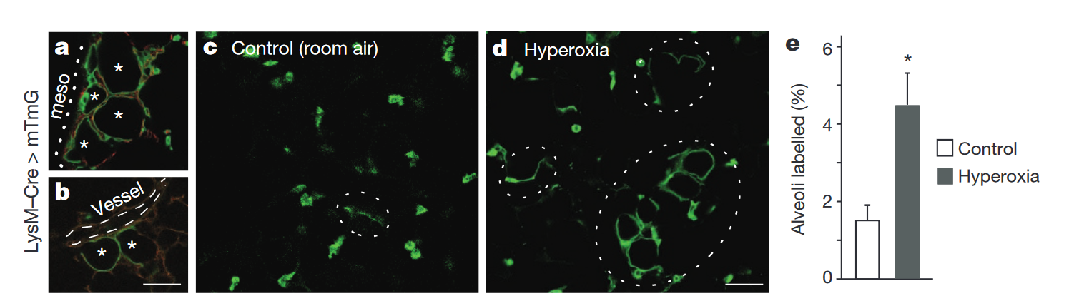
多种成体肺泡再生过程中，AEC2可以转分化成AEC1
“Elevated oxygen tension is toxic to AT1 cells, but not to AT2 cells”
GFP = Lineage-labeled cells
成熟AT2
∴研究转分化过程可以帮助我们更好地理解肺泡再生过程
Desai. Nature. 2014
Notes:
→类器官可以做的一些信号通路实验很多。比如一些敲除/生化/细胞→但是做这些之前，要先搞出来
做这个模型的目的，是要解决科学问题。不是利用这个模型
AT1很重要了
转分化在体内的研究有很多了
体内研究做机制问题：1控制变量2遗传操作局限
损伤会造成
However, acute injury damages alveoli by destroying resident AT1 and AT2 cells, depleting the lung of respiratory capacity. Injury to the lungs is often heterogeneous and can elicit a varied regenerative response depending on the type of damage and its severity (Basil et al., 2020; Sivakumar and Frank, 2019; Whitsett et al., 2019; Xi et al., 2017; Zepp and Morrisey, 2019; Alysandratos et al., 2021). These varying responses are highlighted by distinct alterations in tissue architecture (Zacharias et al., 2018). Appropriate alveolar architecture must be reconstructed to restore gas exchange, which requires the activation of the lung’s resident stem/progenitors: AT2 cells. In response to lung damage, AT2 cells both rapidly proliferate and differentiate into AT1 cells to regenerate alveoli (Barkauskas et al., 2013). Yet, the cellular and molecular processes that regulate these AT2 cell behaviors are poorly understood, due in part to the heterogeneous nature of injury and tissue repair, which makes the investigation of these processes complicated to address empirically. Understanding the molecular mechanisms involved in activating AT2 cell proliferation and driving differentiation into AT1 cells is critical to develop methods to promote alveolar regeneration after lung damage
Figure 3 | Activation of AT2 stem cell function invivo and proliferation invitro.a, b, Renewal foci (AT2 lineage label, green; other cells, red) commonly involve alveoli (asterisks) in peripheral (a, mesothelium, dots) and perivascular (b, dashes) domains. Scale bar, 50 mm. c–e, Alveolar regions under room air (c) or after hyperoxia (88% O2, 5 days) to injure AT1 cells (d). Note increased foci (dashed ovals) after injury. Scale bar, 50 mm. Quantification (e) shows increased alveolar surface (n52; mean 6 s.e.m.) from AT2-lineage labelled cells after hyperoxia. P , 0.05 (Mann–Whitney U test). f, g, Freshly isolated AT2 cells (f, phase contrast) cultured 4 days in Matrigel (g) proliferate, shown by Ki67 staining (red, asterisks), but maintain AT2 marker expression (SftpC, green). h–j, Images (h, i) and quantification (500 cells per biological replicate, n 5 4, 3, 3, 3, 4) (j) of proliferation with EGFR blocking antibody (anti-EGFR, 2.5 mgml21) and EGF ligands indicated (4 mM). Scale bar, 10 mm(f–i). Mean 6 s.e.m.; *P , 0.05; **P , 0.01; ***P , 0.001 (Tukey’s multiple comparisons test).

Slide 6
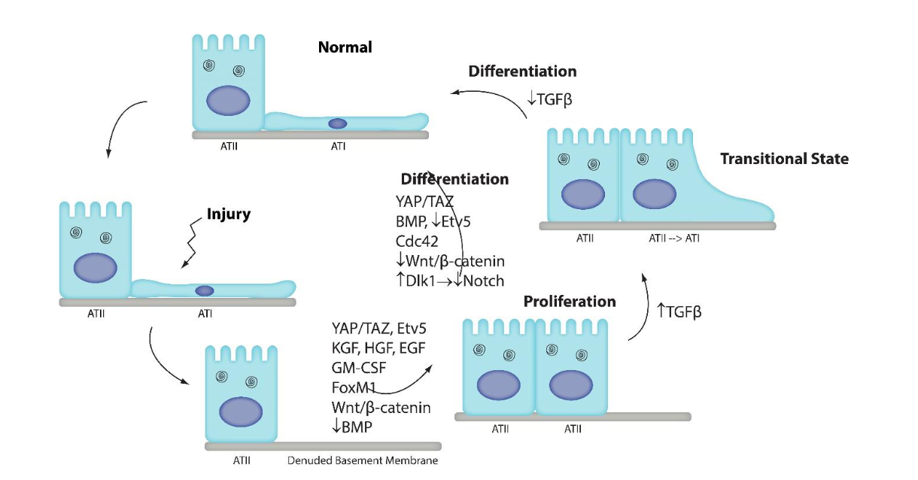
体内的研究揭示了AEC2向AEC1转分化过程中参与的通路
mDL medium
“The up and down-stream signaling events by which these pathways are activated and by which they induce ATI cell differentiation are unknown.
In addition, it is still unknown how the various mechanistic steps from each pathway interact with one another to control differentiation.”
Review
Aspal and Zemans. Int. J. Mol. Sci. 2020
Notes:
依据这些，我们构建里一个体外模型，可以进行控制

Slide 7
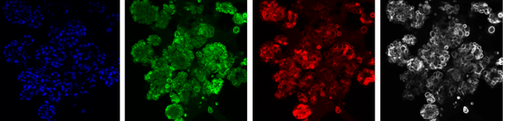
我们构建了一个可以体外再现细胞分化的肺泡类器官模型
Cell sorting
8-12 wks
C57/B6J
0
X₁
X₂
Proliferate
Differentiate
Readout
Hoechest
proSPC(AEC2)
HOPX(AEC1)
KRT8
50 μm
化学成分固定的培养基有助于我们控制AEC2的命运选择。
Qinyi Ma
Notes:
AT1形态不足，进一步查阅文献，是不是中继台？还真是。目前就没有AT1功能

Slide 8
我们构建了一个可以体外再现细胞分化的肺泡类器官模型
Cell sorting
8-12 wks
C57/B6J
0
X₁
X₂
Proliferate
Differentiate
Readout
Hoechest
proSPC(AEC2)
HOPX(AEC1)
KRT8
50 μm
但是绝大多数细胞处于KRT8阳性的中间态。
Qinyi Ma
Notes:
AT1形态不足，进一步查阅文献，是不是中继台？还真是。目前就没有AT1功能

Slide 9
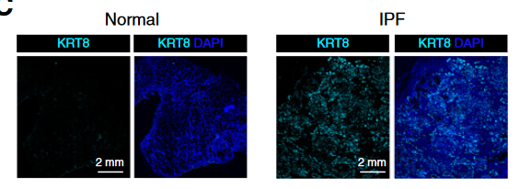
正常肺泡损伤修复需要突破中间态得到有功能的AEC1
scRNA-seq组学研究进一步表明IPF病理细胞停滞在KRT8+中间态
主要症状：呼吸困难
Jiang et al. Am J Respir Crit Care Med. 2020
Notes:
中间态案例 *4 加上来。说明中间态不够，没有功能

Slide 10
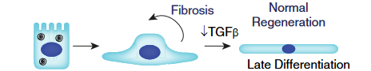
科学问题：
AEC2如何突破中间态以转分化为成熟的AEC1？
?

Slide 11
研究内容
类器官筛选体系建立
添加候选因子并读出
代表性分子实验
①稳定高活性的分选体系建立
  BF表型和IF表型
②稳定的读出建立
  RT-qPCR（及标志物确定）
聚焦细胞之间的“差异”
来源：
①in vivo scRNA-seq
②文献阅读
以转录因子KL5为例
说明类器官的潜力

Slide 12
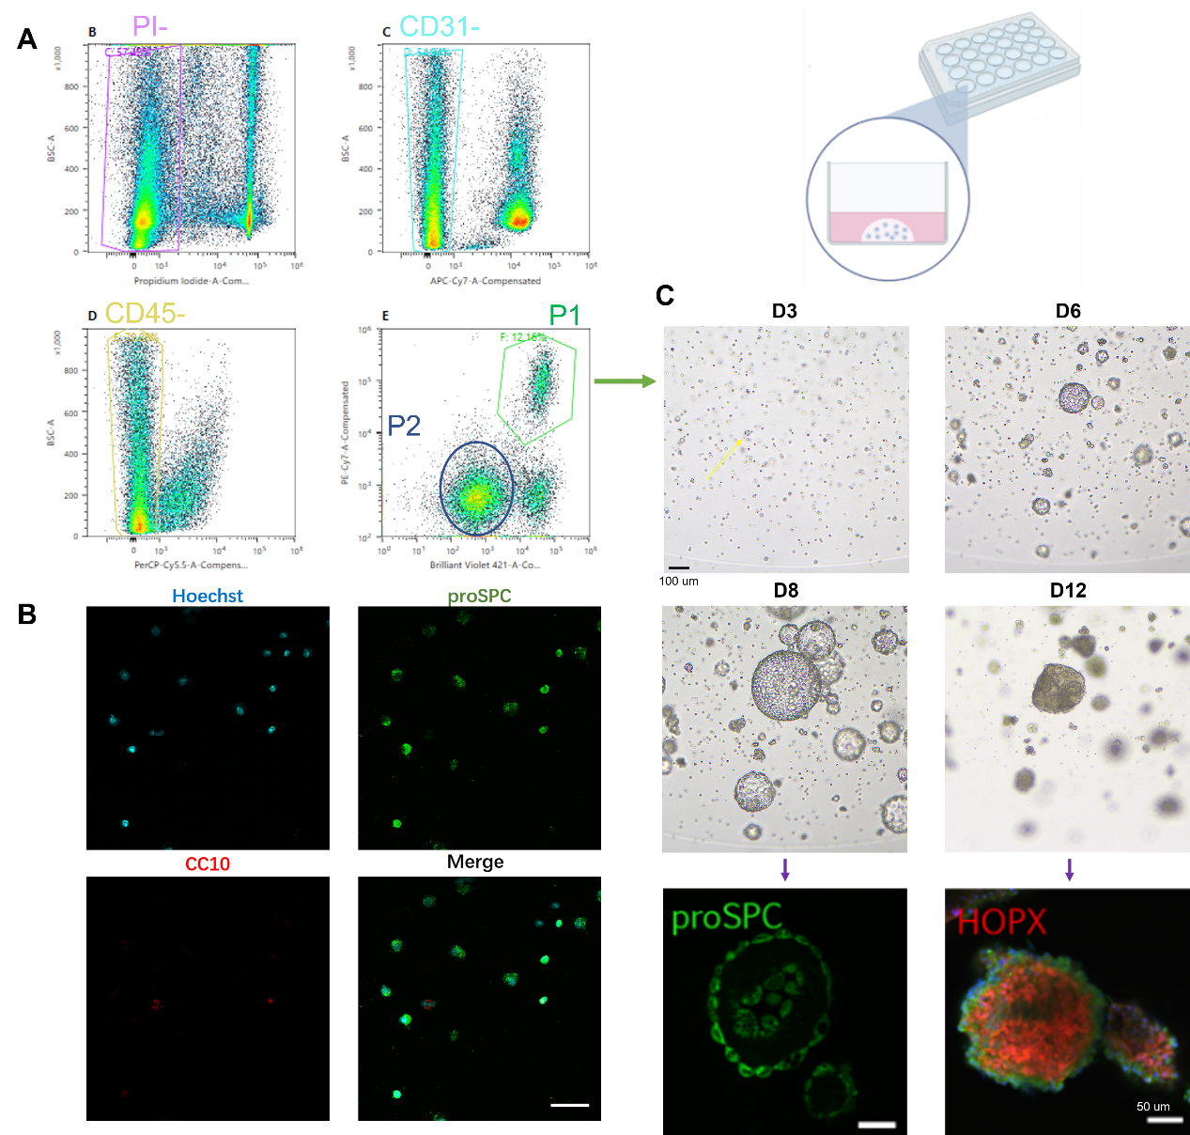
二阶段纯上皮肺泡类器官的构建
利用流式细胞术分选AEC2并验证其纯度

Slide 13
二阶段纯上皮肺泡类器官的构建

Slide 14
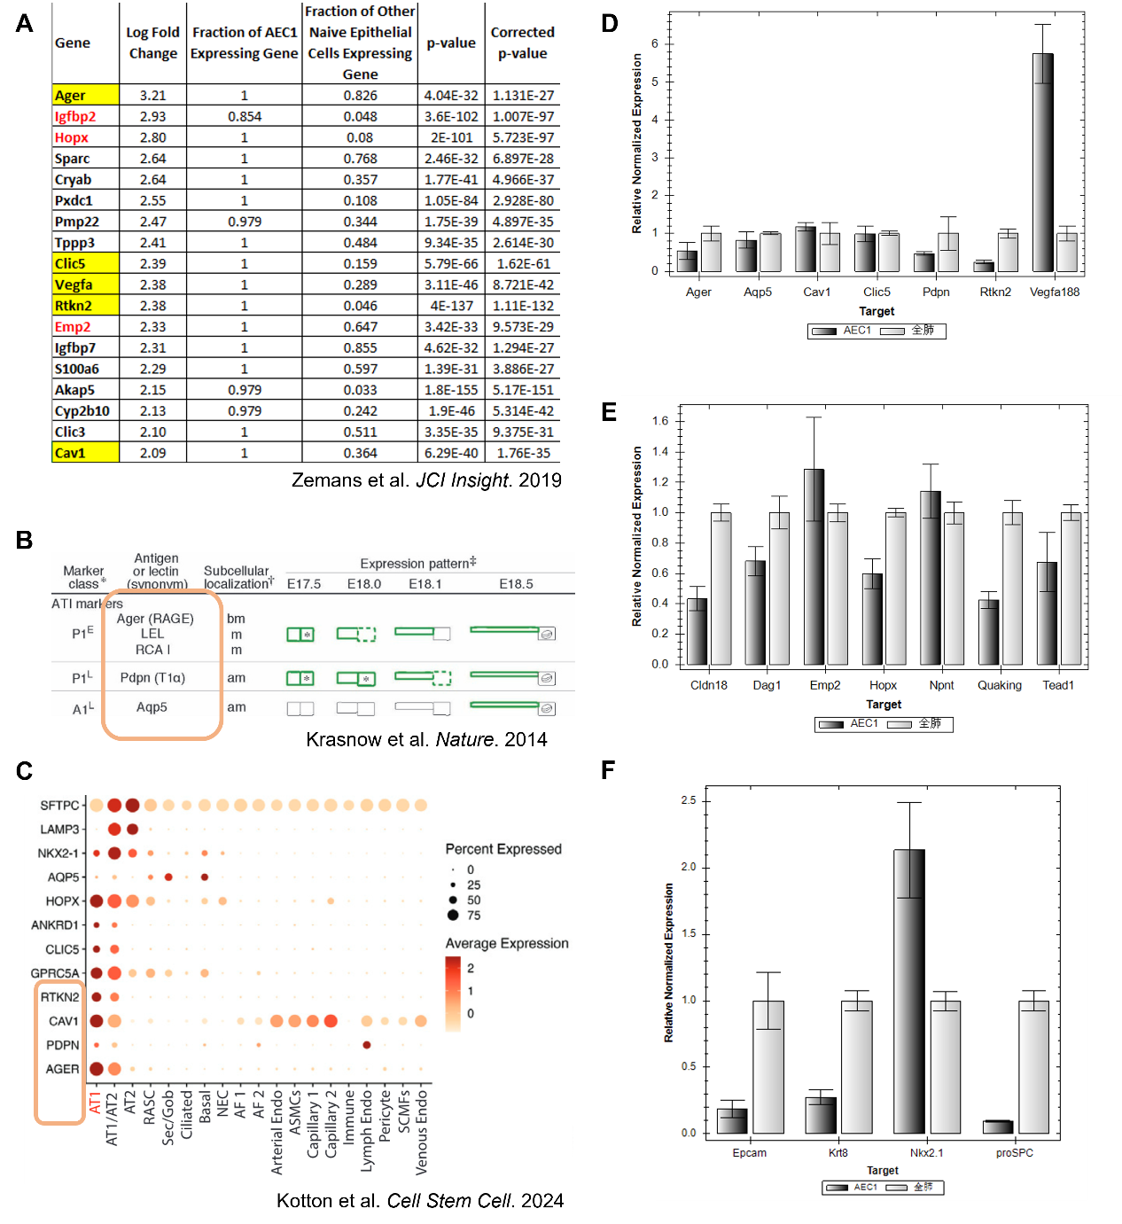
qPCR读出标志物的选择和确立

Slide 15

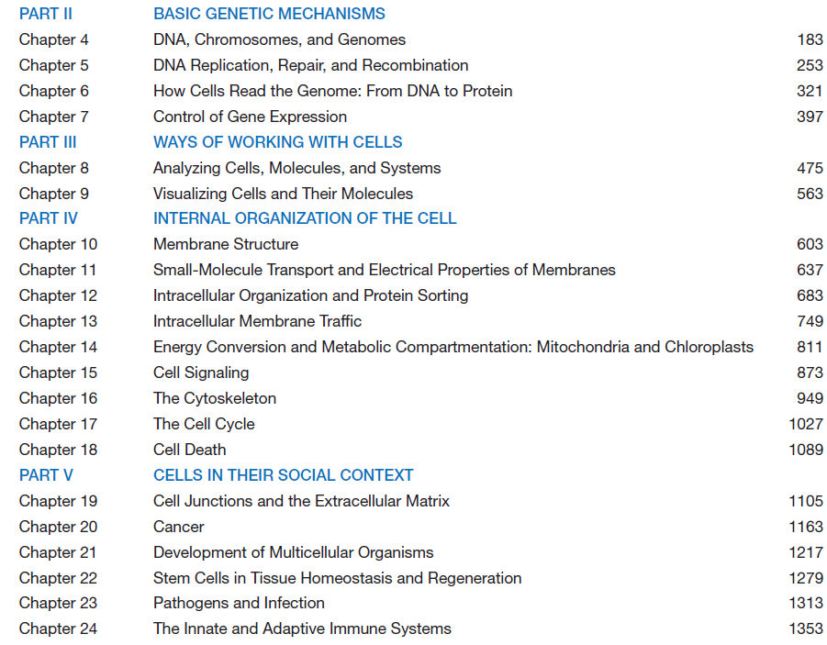
如何考虑两种细胞差异？
①基因表达
②新陈代谢
③机械力/细胞形态
④细胞所处微环境（~niche）

Slide 16
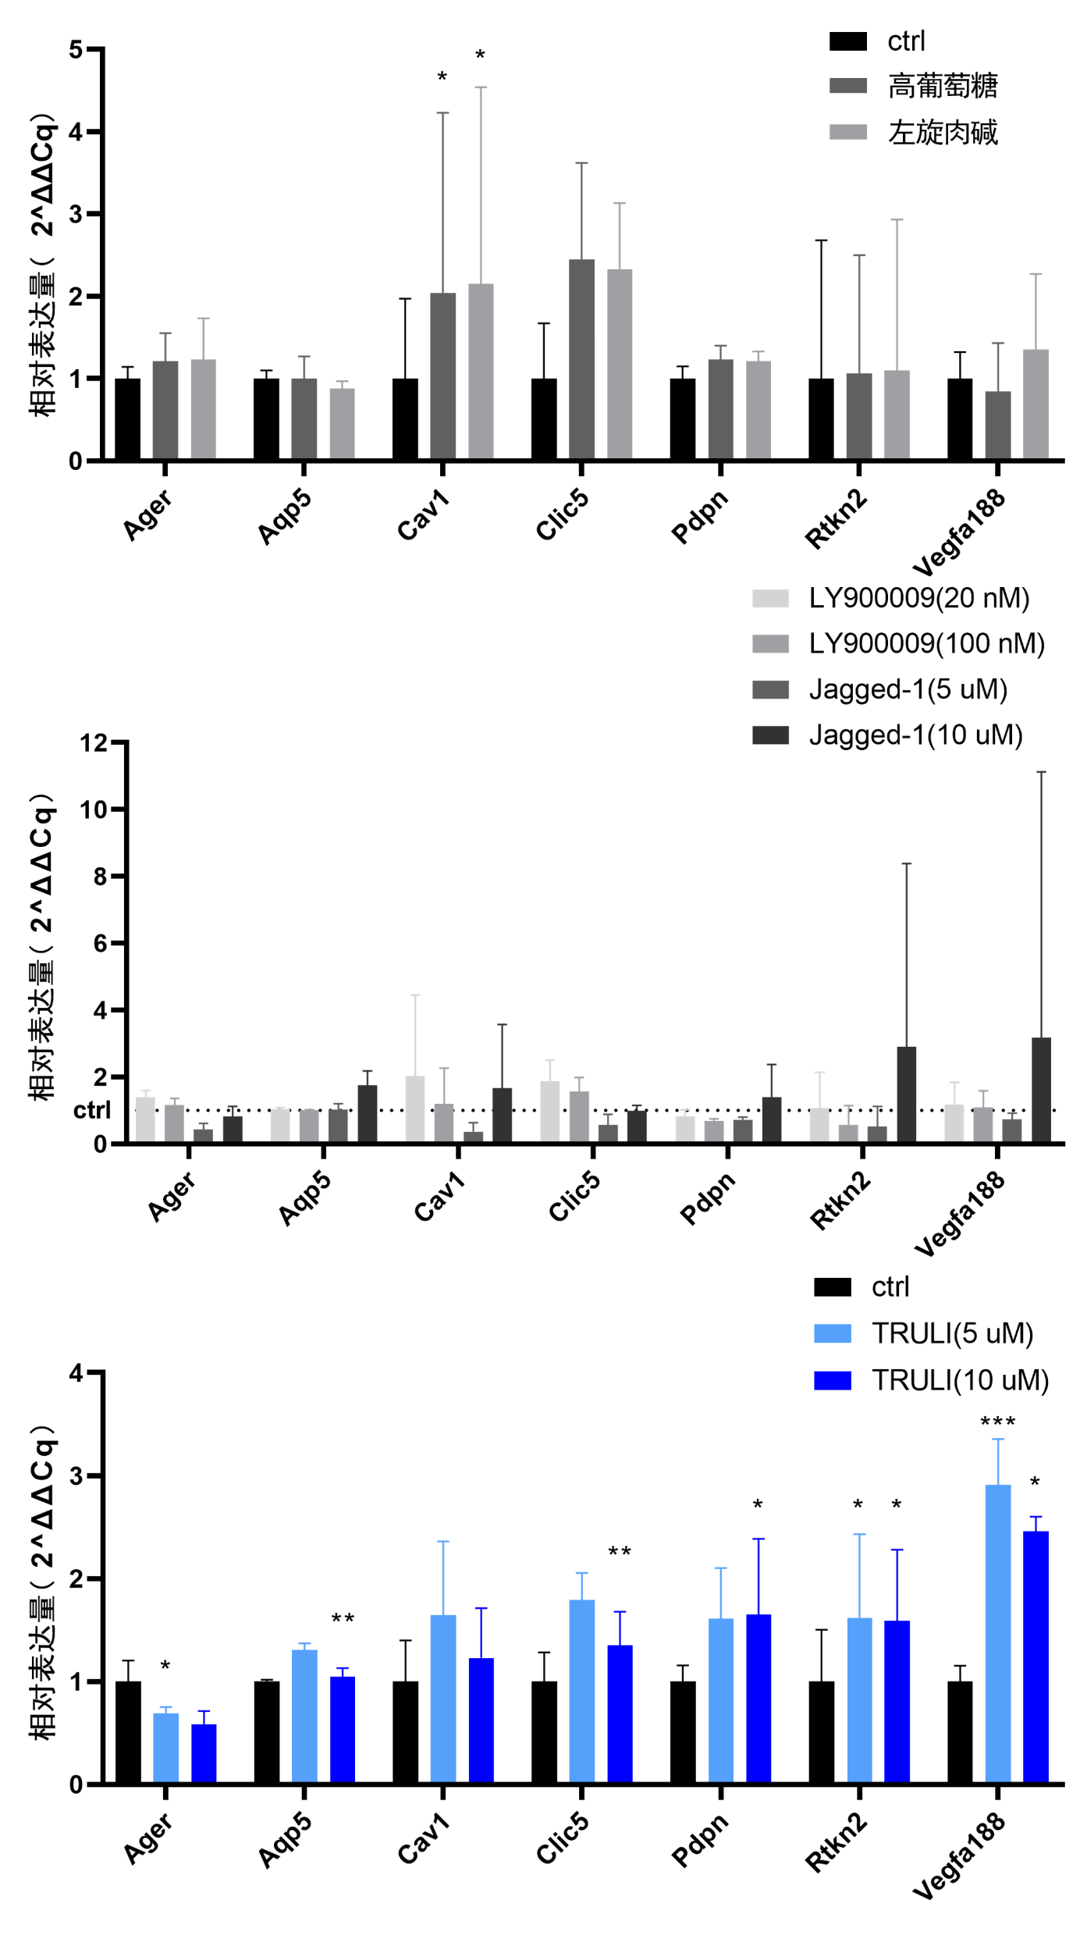
实验结果：添加物对AEC1成熟的影响
糖脂代谢的加强均可以提高Cav1和Clic5的水平

Slide 17
实验结果：添加物对AEC1成熟的影响
Notch通路抑制剂
Notch通路激动剂
LY90009和Jagged-1基本不影响AEC1成熟标志物的水平
Notes:
3.1.1和3.1.2的结果成功建立了一套筛选AEC1成熟的方案。接着通过对已有的细胞生物学知识分析，我们确定了①基因表达/信号转导 ②新陈代谢 ③机械力和细胞形态 ④细胞所处微环境，这4个方面作为筛选通路的范围。由于③的实现较为困难，目前暂时搁置。通过文献阅读，最终选择了左旋肉碱（可促进脂肪酸代谢）、高葡萄糖（可促进糖代谢）、LY90009（γ-secreatase抑制剂，Notch通路的抑制剂）、Jagged-1（Notch的配体，可激活Notch通路）和TRULI（LATS1/2的抑制剂，可防止YAP/TAZ被磷酸化修饰，进而促进YAP/TAZ入核发挥功能）作为第一批筛选的药物。与第八天换成分化培养基的同时添加药物，处理4天后收集RNA进行RT-qPCR进行读出。结果表明糖脂代谢的加强均可以提高Cav1（显著）和Clic5这两个膜蛋白的mRNA水平，而对其余标志物影响较小。而LY90009和Jagged-1对于AEC1成熟标志物的水平基本不影响，尽管有一组Jagged-1的生物学重复中的Rtkn2和Vegfa188显著高表达，但实际上是那一组实验的铺板密度有所提升，可能间接推动了分化的进程，其余两个重复没有显著变化。这也侧面说明了加药时间点等细节还需要进一步标准化。对Notch通路的影响整体上对成熟AEC1标志物浮动水平不大，且其对Notch下游的报告基因Hes1 mRNA水平表达作用与预期恰好相反，这意味着对简单添加小分子不足以对Notch这样一个依赖细胞接触的通路有作用，抑或其本身具有明显的负反馈机制。TRULI组都能提升Ager和Aqp5以外的AEC1成熟标志物，其中对于Vegfa188、Clic5和Aqp5的作用及其显著。但是和文献报道^{[18]}的不一致的是，YAP/TAZ下游的报告基因Ankrd1的mRNA水平却仍然是下调的情况（未展示），两次出现报告基因的反向“报告”意味着小分子等物质的作用可能仍然有未知效应，不能完全替代基因操作等实验。另外，TRULI的处理能显著地下调proSPC的水平，同时维持Epcam水平几乎不变，说明了其确实有在推动转分化过程。综上，以上的结果说明了TRULI可以促进AEC1成熟标志物Vegfa188和Rtkn2的表达，而糖脂代谢可以促进Cav1和Clic5的表达。这一部分说明了AEC1的成熟可能需要多个通路协调，或者是一个多阶段的事件，也说明了我们的体系可以
筛选出这些潜在通路。

Slide 18
实验结果：添加物对AEC1成熟的影响
LATS1/2的抑制剂
~YAP/TAZ的激动剂
TRULI组都能提升Ager和Aqp5以外的AEC1成熟标志物，其中对于Vegfa188、Clic5和Aqp5的作用及其显著。

Slide 19
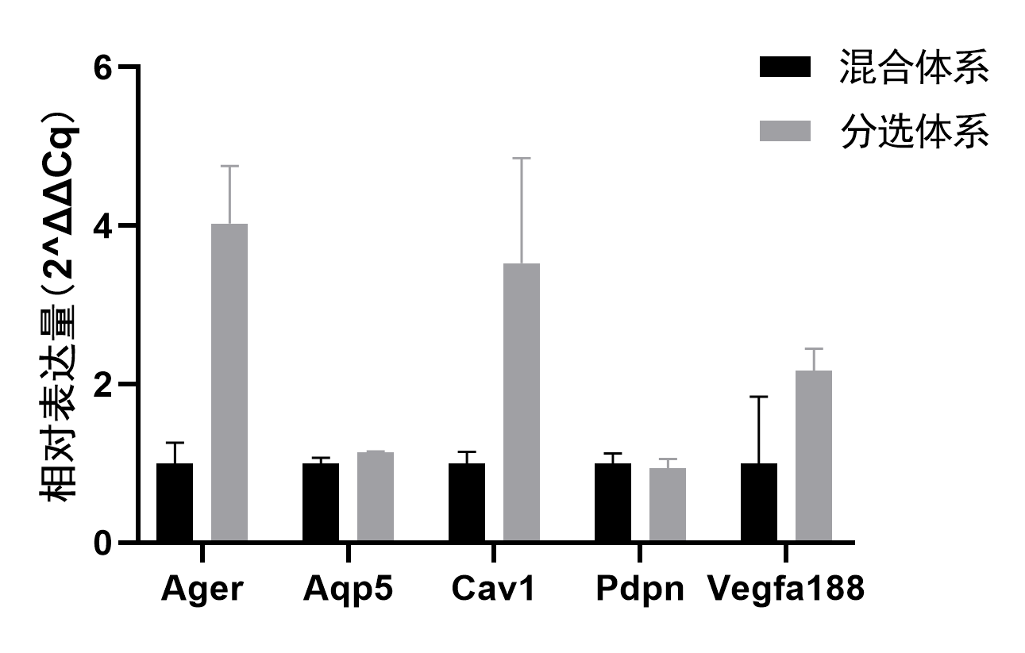
实验结果：非上皮细胞对AEC1成熟的影响
混合体系中AEC1成熟的标志物表达水平普遍低于分选体系，这一方面也说明了其余细胞的分泌作用更多是维持AEC2的增殖而非分化。

Slide 20
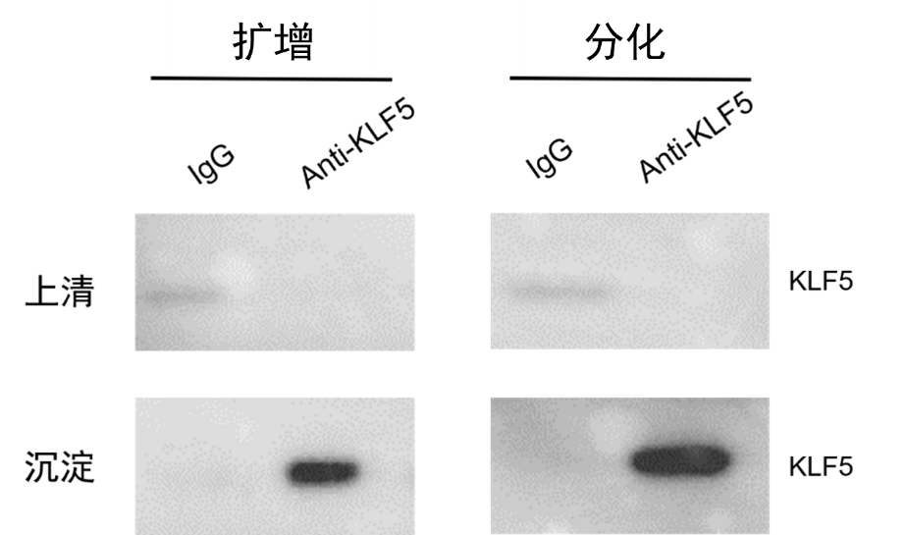
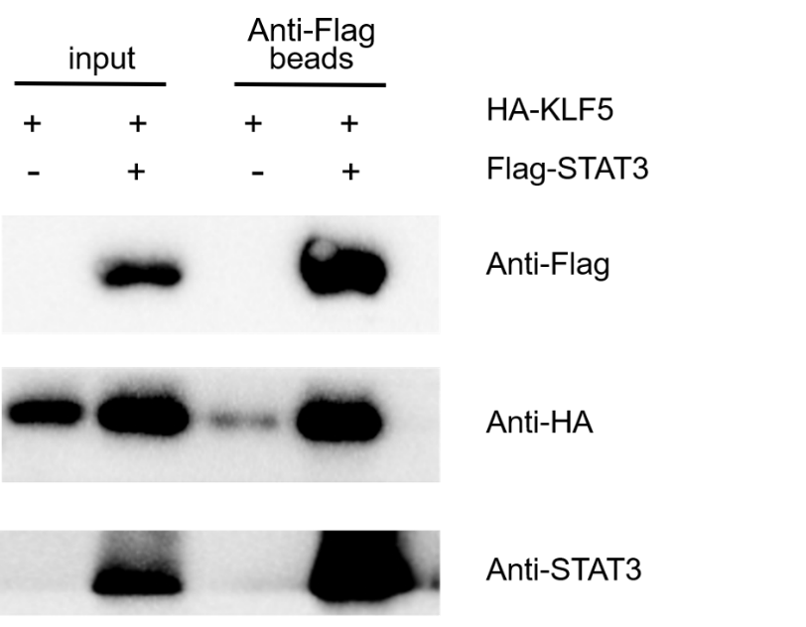
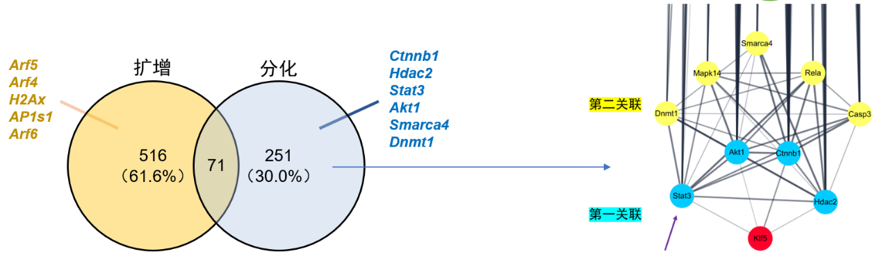
类器官机制研究的潜力：以KLF5研究为例
外源CO-IP验证
IP-MS/MS

Slide 21
小结
本项目分为两个部分：
①构建肺泡损伤修复的体外模型，进而筛选得到脂肪酸代谢和YAP/TAZ通路可以促进AEC2向AEC1转分化成熟的过程。展现了类器官的高通量优势。
②利用该模型尝试分子机制的研究，并发现了转分化过程中，相对增殖特异性的KLF5互作因子STAT3。展现了类器官作为体外模型研究分子机制的优势。

Slide 22
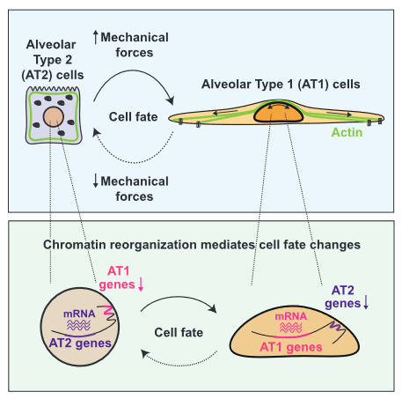

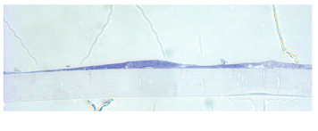
展望
在考虑筛选因素的时候，机械力和细胞形态虽然没有被纳入，但是其仍然是AEC1重要的特征。
Shiraishi et al. Cell. 2023

Slide 23
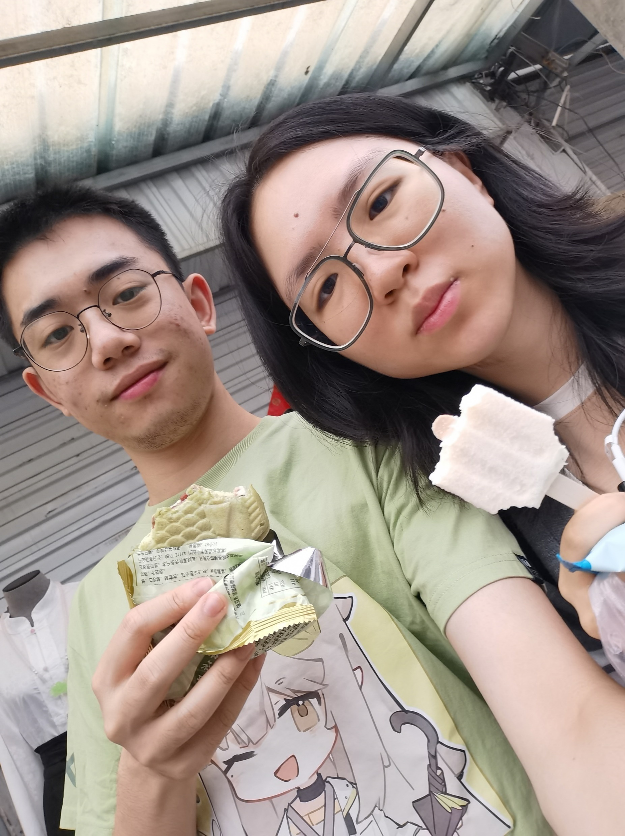
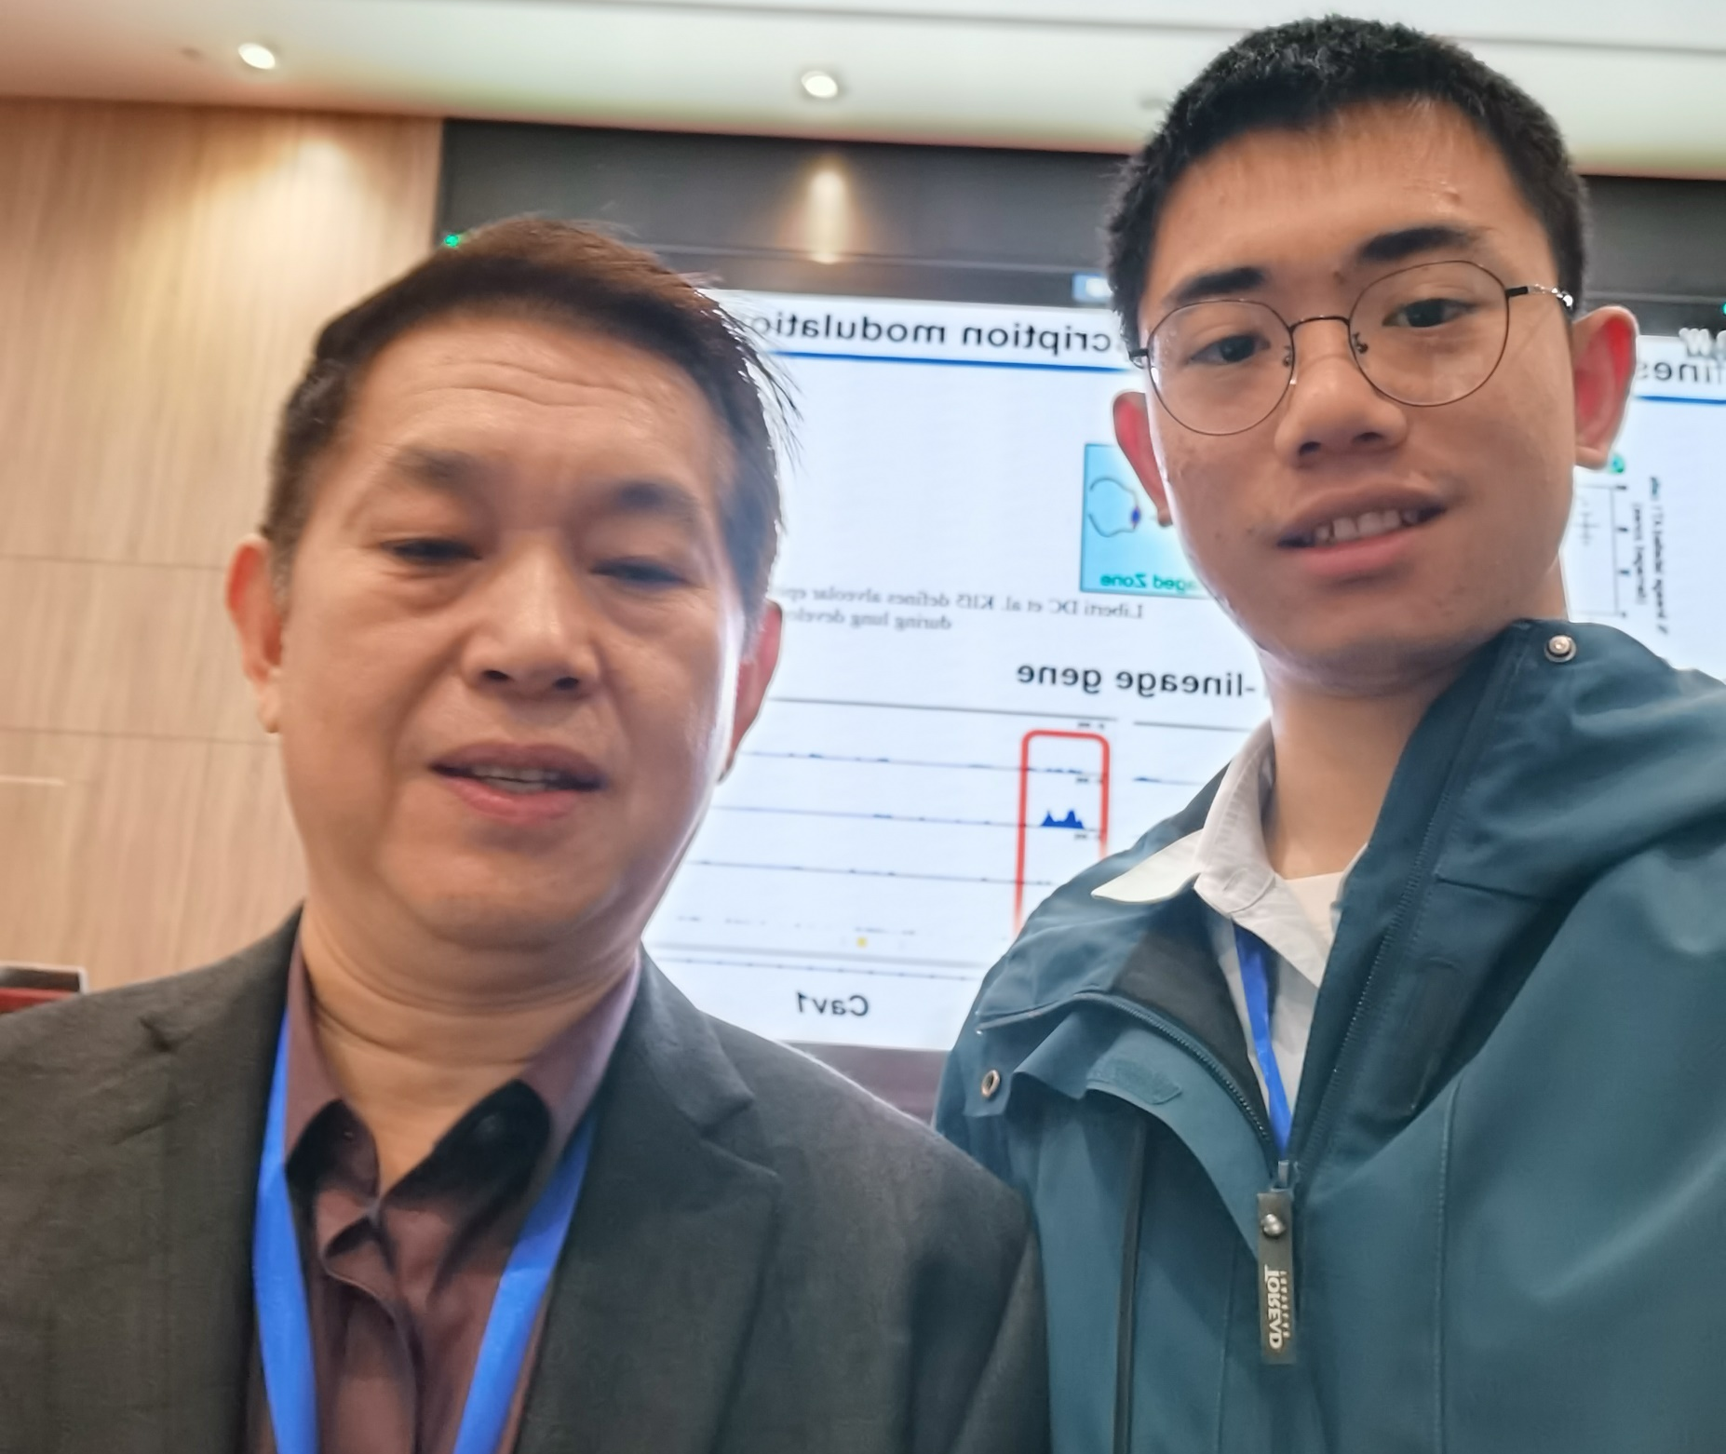

致谢
导师：林鑫华教授
“好肺”小组

