Slide 1

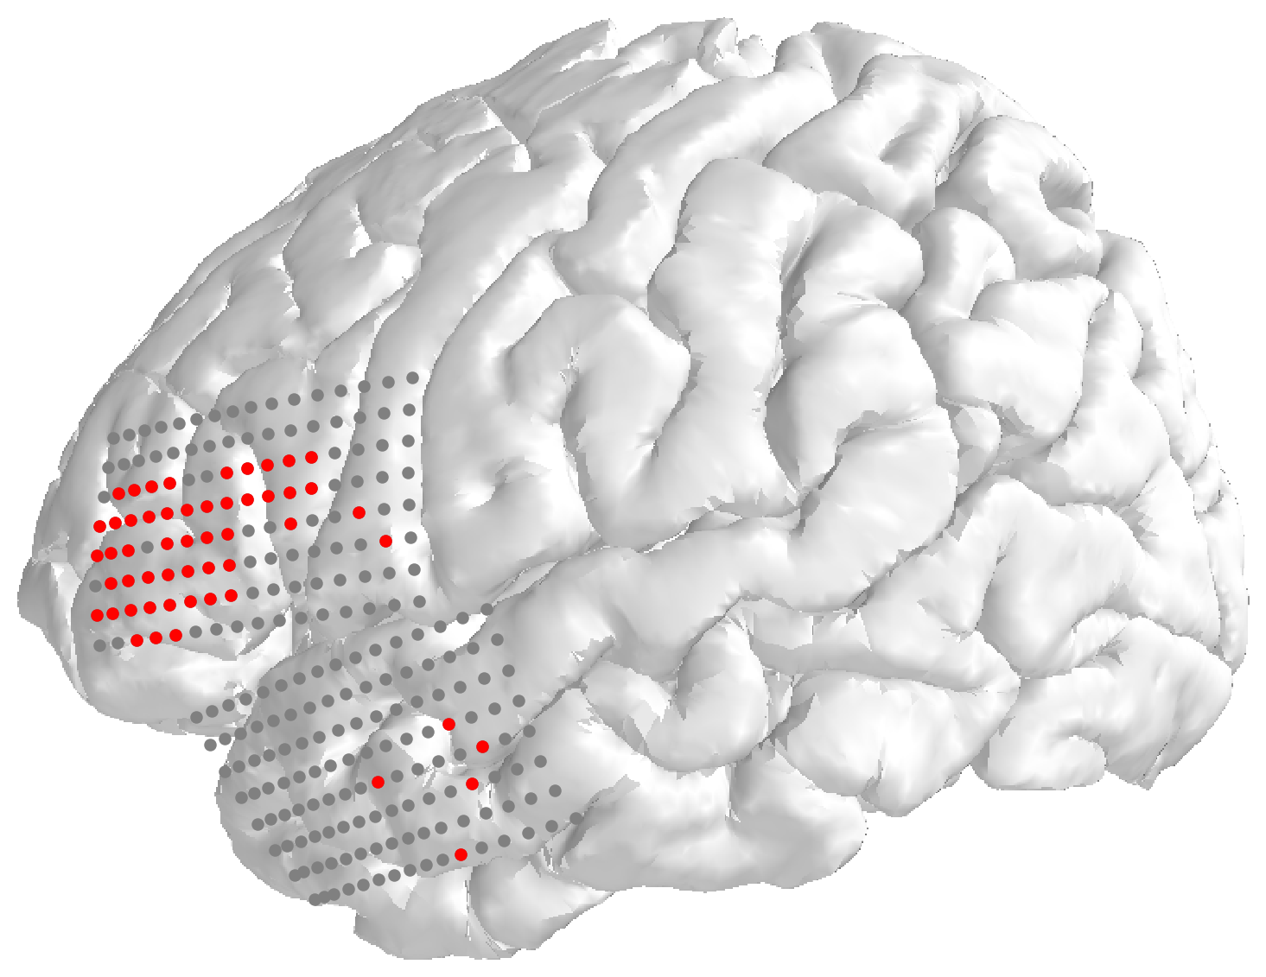
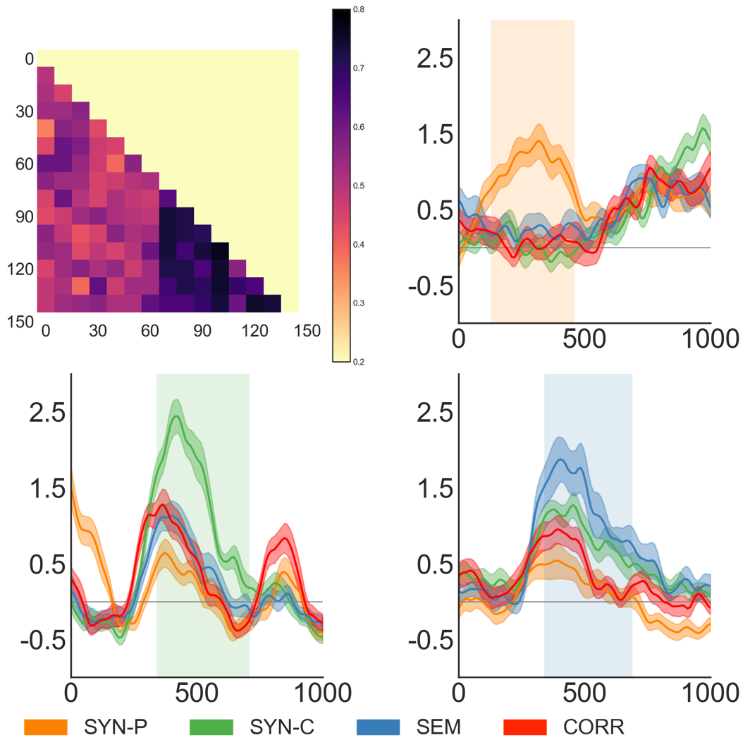
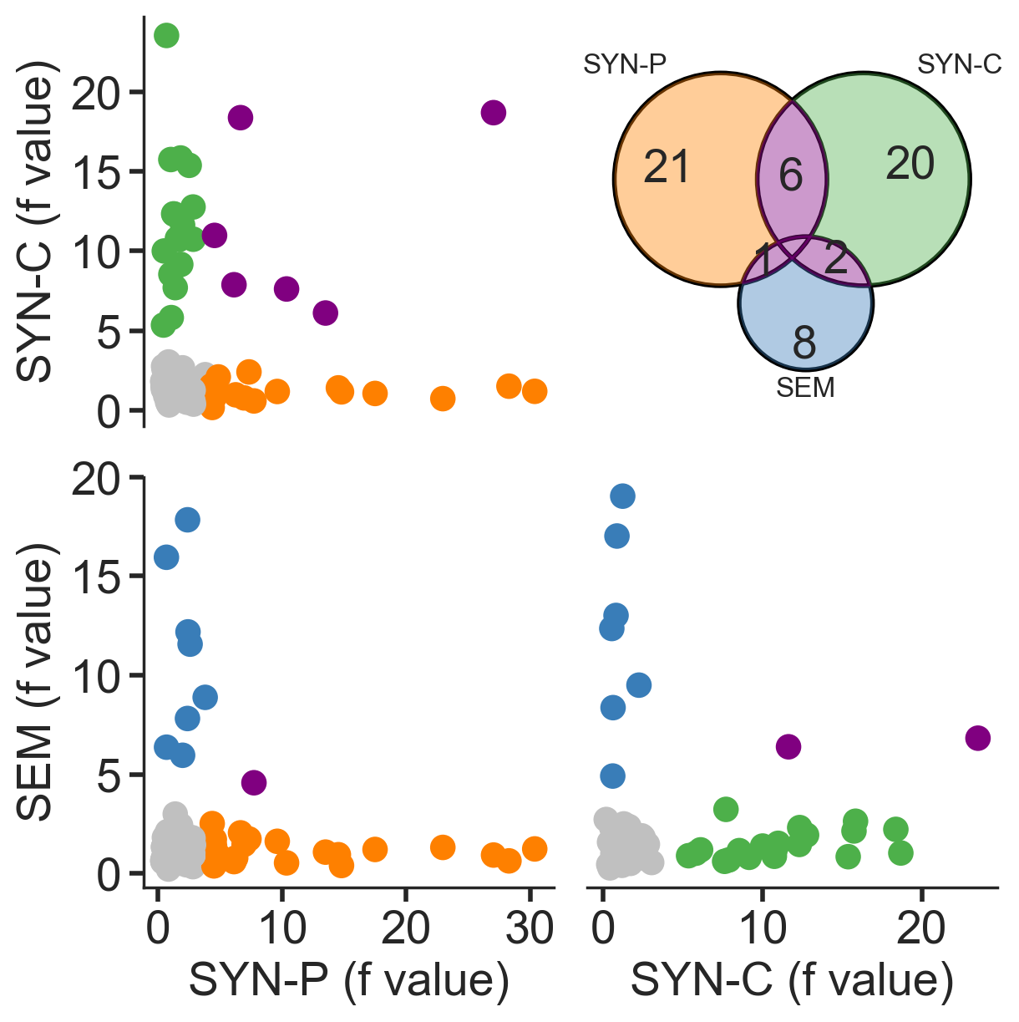
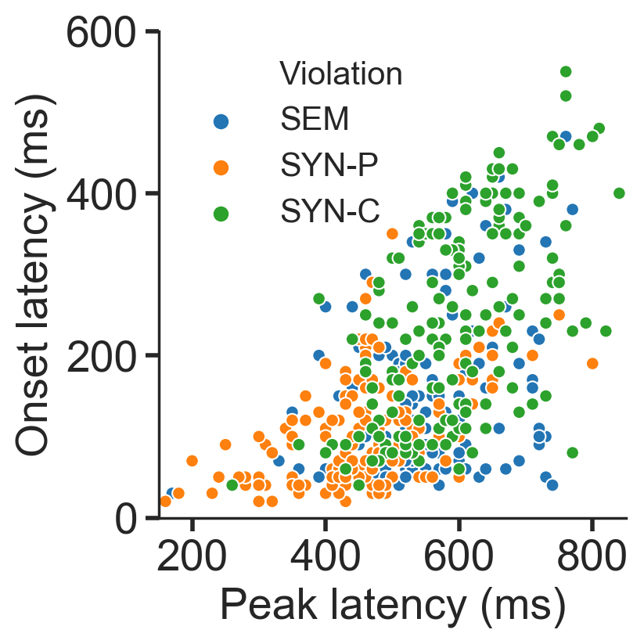
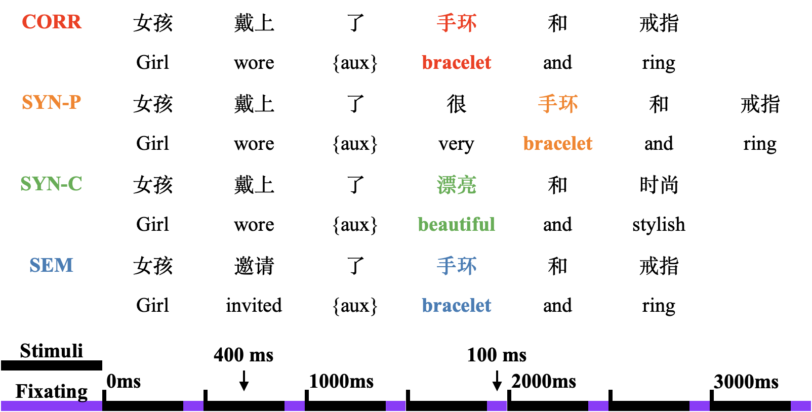
Distinct spatiotemporal patterns of syntactic and semantic processing in human inferior frontal gyrus
Yanming Zhu, Min Xu, Junfeng Lu, Jianhua Hu, Jinsong Wu, Lihai Tan
Huashan Hospital & Shenzhen Institute of Neuroscience, wujinsong@huashan.org.cn
Background
Neuropathic Pain
One prominent linguistic theory proposed by Noam Chomsky and many others assumes that the syntactic computational system is a core component of human language, which generates internal representations and maps them into the sensory-motor (phonological) and conceptual-intentional (semantic) systems. This theory has led to a long-standing tradition of distinguishing specialized modular center for syntactic processing from other linguistic components in the brain. In contrast to the modularity view, there is growing evidence showing that both syntactic and semantic processing activates a frontal-temporal network including IFG and middle/superior temporal areas, but none of these areas is strictly syntax- or semantic-specific, leading to a different position that the processing of syntactic and semantic information is highly integrated, rather than according to regionally dedicated modules. In line with the neuroimaging evidence, aphasia research also reveals that patients with syntactic deficits do not have a common lesion in the brain.
Aims
Fig.1 Linguistic responding electrodes at IFG
Fig. 2 High-gamma discriminated conditions and representative electrodes
To test weather the human brain process the syntax and semantics component independently or non-independently on spatial and temporal aspect. Or the human brain instantiates the modularity of syntax at a finer scale, such that syntactic and semantic processes may be implemented by different subnetworks of cells distributed within the critical language region such as IFG. Yet the dissociations at the finer scale cannot be reliably differentiated with traditional functional imaging techniques.
Method
We used high-density electrocorticography (ECoG) and examined whether syntactic and semantic processes could be dissociated in the left IFG. 10 native Mandarin-speaking participants (right-handed, six females; 19-50 years of age) undergoing awake brain mapping were recorded using two 128-electrode grids, which were located on the surface of the exposed cortex, while participants processed Chinese sentences and determined whether the presented written sentences were correct.
Fig.3 Electrodes separation by F-value of electrodes to each violation condition and Venn diagram
Fig.4 Temporal dissociation, onset, and peak delay of all responding electrodes
Conclusion
Result
The results demonstrated distinct spatiotemporal patterns of activity in the left IFG that were specifically associated with syntactic and semantic processing. Indicating that this region was differentiated into distinct circuits that independently processed syntactic and semantic information in their corresponding time courses, offering strong evidence for the universality theory of syntactic processes. Our findings revealed that syntactic and semantic processes were implemented as a heterogeneous mix of modules at distributed circuits without clustering into distinct subregions in the left IFG. This may represent a more general principle of neural organization for the brain regions with highly heterogeneous functions. Our findings are essential to advance the understanding of the universality and specificity of neural mechanisms and neural decoding underlying human language.
1. Most of the electrodes showing enhanced activities to linguistic stimuli were located in the IFG.
2. High-gamma components (>70Hz) discriminated conditions with the highest accuracy and event-related potentials were more prominent at high gamma band. Representative electrodes further verified that the manipulation of semantic or syntactic caused enhanced neural activities.
3. Most of the electrodes (49/58) strongly responded to only one type of violation. For the electrodes responding to the combined violation condition (COM), 78.3% of them also showed enhanced activity to the syntactic violation (SYN-P), but only 26.1% of them responded to the semantic violation (SEM), which may indicate a functional primacy of syntactic analysis. The neural responses to syntactic processing were spatially separated from semantic processing and non-linguistic processing at the single electrode level but not at a larger scale.
4. The SYN-P (onset:113 ms and peak: 480 ms) occurred earlier than SEM (122 ms and 524 ms) and SYN-C (283 ms and 579 ms) in terms of both onset and peak of the response.
Pinker, S. Rules of language. Science 253, 530-535 (1991).
Dapretto, M. & Bookheimer, S. Y. Form and Content: Dissociating Syntax and Semantics in Sentence Comprehension. Neuron 24, 427-432 (1999).
Friederici, A. D., Chomsky, N., Berwick, R. C., Moro, A. & Bolhuis, J. J. Language, mind and brain. Nature Human Behaviour 1, 713-722 (2017).
Pylkkänen, L. The neural basis of combinatory syntax and semantics. Science 366, 62-66 (2019).
Hagoort, P. The core and beyond in the language-ready brain. Neurosci. Biobehav. Rev. 81, 194-204 (2017).
Dronkers, N. F. A new brain region for coordinating speech articulation. Nature 384, 159-161, doi:10.1038/384159a0 (1996).
Embick, D., Marantz, A., Miyashita, Y., Oneil, W. & Sakai, K. L. A syntactic specialization for Broca's area. Proc. Natl. Acad. Sci. U. S. A. 97, 6150-6154 (2000).
Glaser, Y. G., Martin, R. C., Van Dyke, J. A., Hamilton, A. C. & Tan, Y. Neural basis of semantic and syntactic interference in sentence comprehension. Brain Lang. 126, 314-326 (2013).
Anumanchipalli, G. K., Chartier, J. & Chang, E. F. Speech synthesis from neural decoding of spoken sentences. Nature 568, 493-498, doi:10.1038/s41586-019-1119-1 (2019).
Acknowledgement: This work was supported by Institute of Brain-Intelligence Technology of Zhangjiang Lab (ZJ2018-ZD-012), Shanghai Municipal Science and Technology Major Project (No.2018SHZDZX01), Shanghai Shenkang Hospital Development Center (SHDC12018114), Shanghai Rising-Star Program (No. 19QA1401700) and Shanghai Young Talents Program (No. 2017YQ014).

